Slide 1
Unix commands (I)
Instructor: Li Feng
Capital University

Slide 2
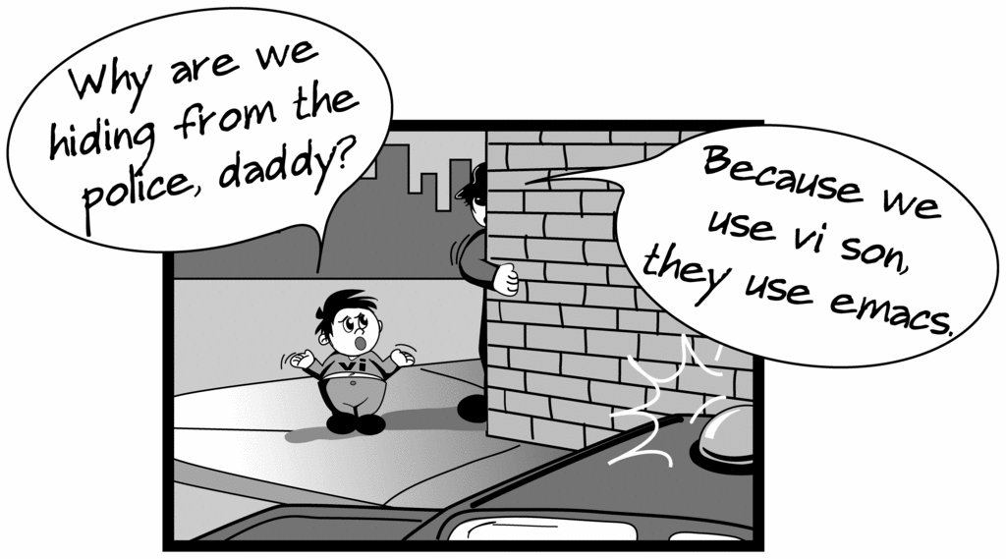
Creating files in Linux
Various Editors:
vim
Emacs
Notes:
Unix Web Resources
http://www.ee.surrey.ac.uk/Teaching/Unix/

Slide 3
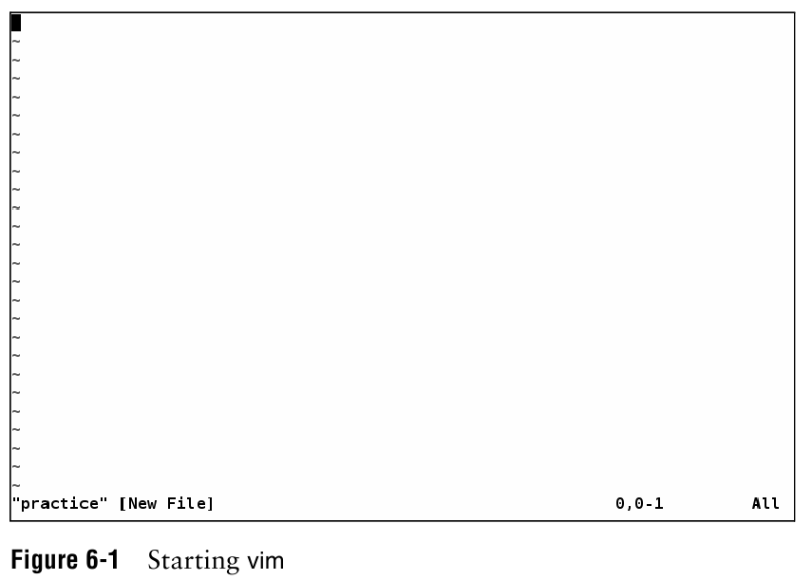

Slide 4
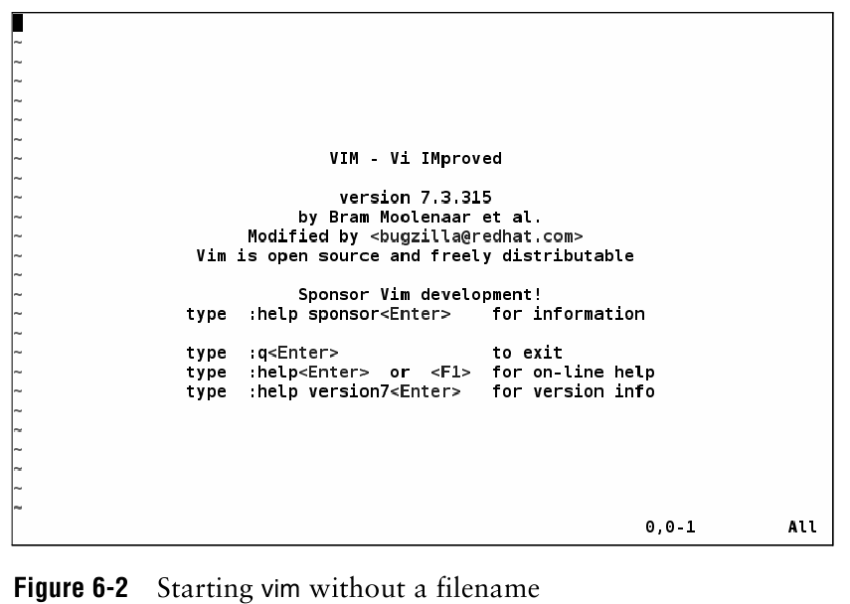

Slide 5
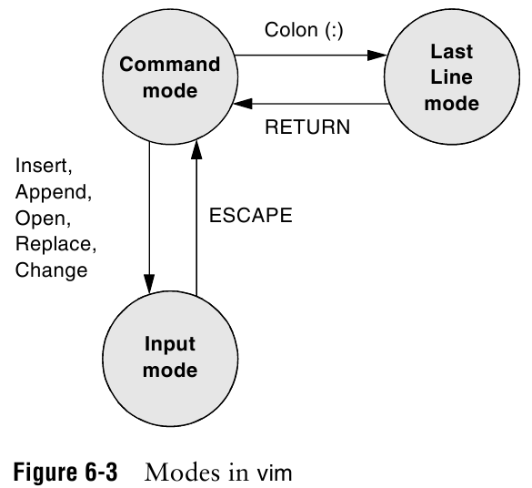

Slide 6
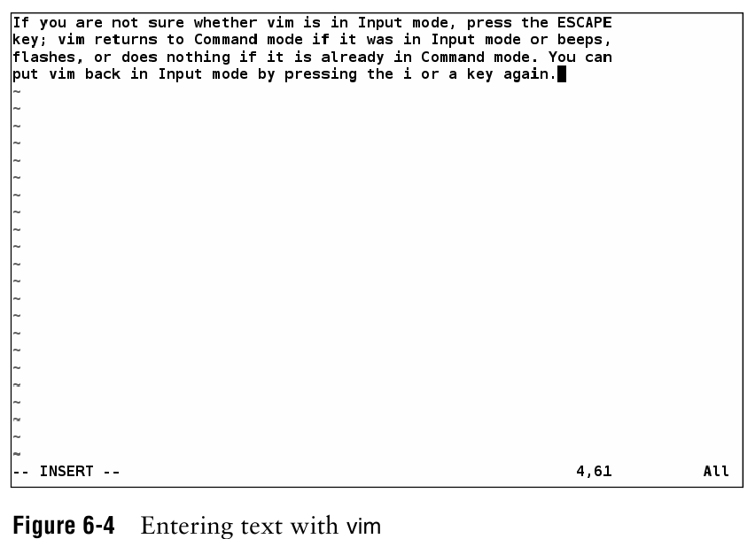

Slide 7
Create a short file using Vim
vim unixfile.txt
Initially, it is the command mode.
Type the letter i to enter input mode.
Within input mode, type a couple of lines, end each line with a RETURN.
Before you exit from vim, press ESCAPE to command mode.
Type ZZ to write the new file to disk and exit form vim. (Or :wq to save, :q! to not save)

Slide 8
Create a file using “cat”
cat > unixfile.txt
Type the text
Ctrl + D to stop and save the text to unixfile.txt

Slide 9
Displaying a file
Various ways to display a file in Linux
cat
less
head
tail

Slide 10
Command: cat (concatenate)
Dumps an entire file to standard output
Good for displaying short, simple files

Slide 11
Command: less
“less” displays a file, allowing forward/backward movement within it
return scrolls forward one line, space one page
y scrolls back one line, b one page
use “/” to search for a string
Press q to quit

Slide 12
Command: head
“head” displays the top part of a file
By default it shows the first 10 lines
-n option allows you to change that
“head -n50 file.txt” displays the first 50 lines of file.txt

Slide 13
Command: tail
Write the last ten lines of a file to the screen

Slide 14
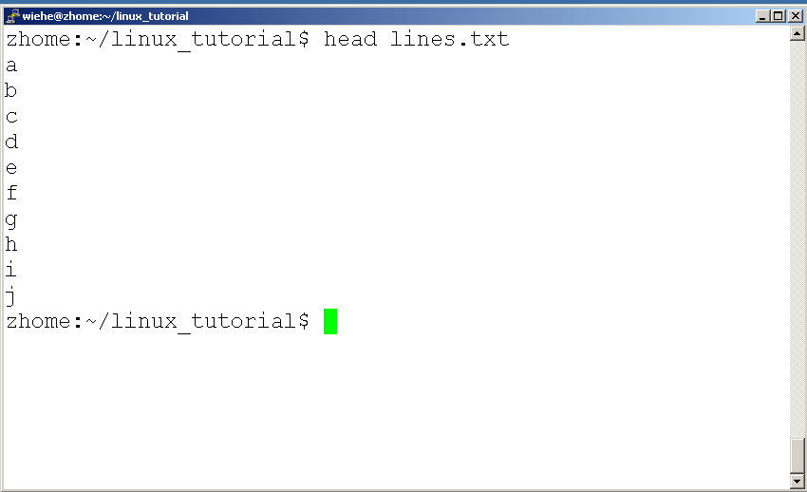
Command: head

Slide 15
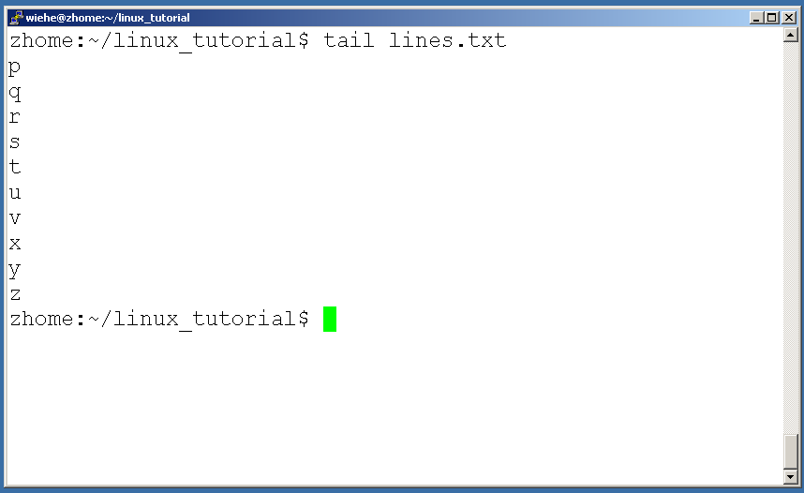
Command: tail

Slide 16
Command: tail

Slide 17
Searching the contents of a file
less
grep
wc (word count)

Slide 18
Command: less
In “less”, type a forward slash “/” followed by the word to search
Less will find and highlights the keyword.
Type “n” will search for the next occurrence of the word

Slide 19
Command: grep
Search files for specified words or patterns
Case sensitive
-i: ignore upper/lower case distinctions
-v: display those lines that do NOT match
-c: print only the total count of matched lines
Notes:
-w a word

Slide 20
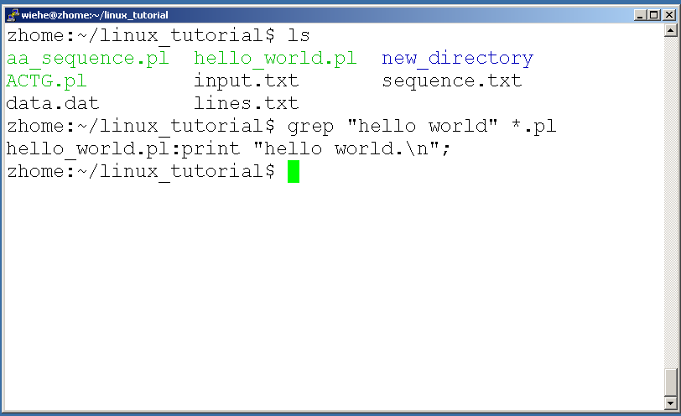
Command: grep
To search files in a directory for a specific string use “grep”
You must quote regular expressions that contains special characters, SPACE, or TABs.

Slide 21
Command: wc
To count the characters, words, and lines in a file use “wc”
The first column in the output is lines, the second is words, and the last is characters
-w: count word in the file
-l: count number of lines in the file

Slide 22
File Commands
Copying a file: cp
Move or rename a file: mv
Remove a file: rm

Slide 23
Copying Files: cp
cp source-file destination-file
(makes a copy of source-file in the current working directory and calls it destination-file)

Slide 24
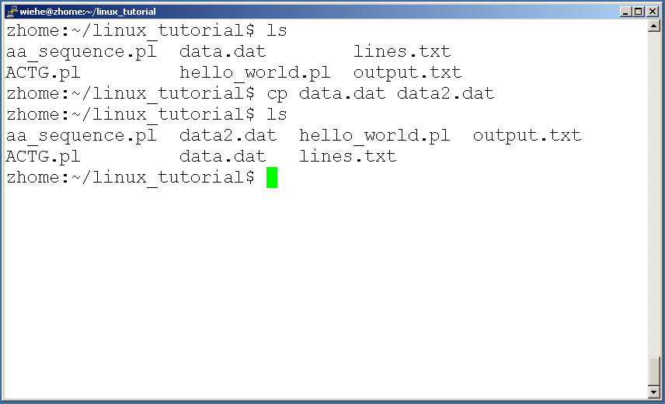
Command: cp

Slide 25
Moving file: mv
mv existing-file new-filename
Move a file from one place to another (only one file rather than two)

Slide 26
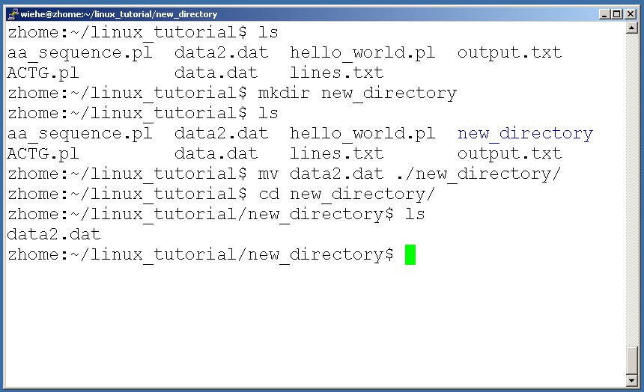
move a file to a different location use “mv”

Slide 27
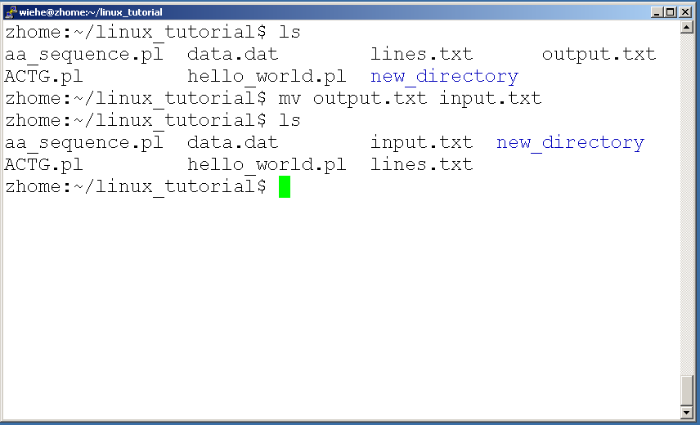
mv can also be used to rename a file

Slide 28
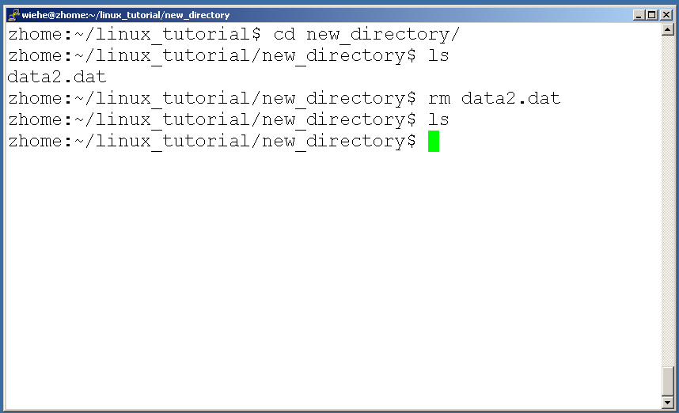
Removing files: rm
rm file2

Slide 29
Command: rm
To remove “recursively”: rm –r
Used to remove all files under directories
Be very careful, deletions are permanent in Linux

Slide 30
Command: diff, sort, uniq
To compare to files for differences: diff
diff –u file1 file2
Displays a file in order: sort (alphabetic order)
sort filename
Remove duplicate lines from a file: uniq
uniq filename
Notes:
-u: unifed output format

Slide 31
Input/Output Redirection
Programs can output to other programs
“program_a > file.txt”
program_a’s output is written to a file called “file.txt”
“program_a < input.txt”
program_a gets its input from a file called “input.txt”

Slide 32
Command: Pipeline “|”
Communication between processes
“program_a | program_b”
program_a’s output becomes program_b’s input

Slide 33
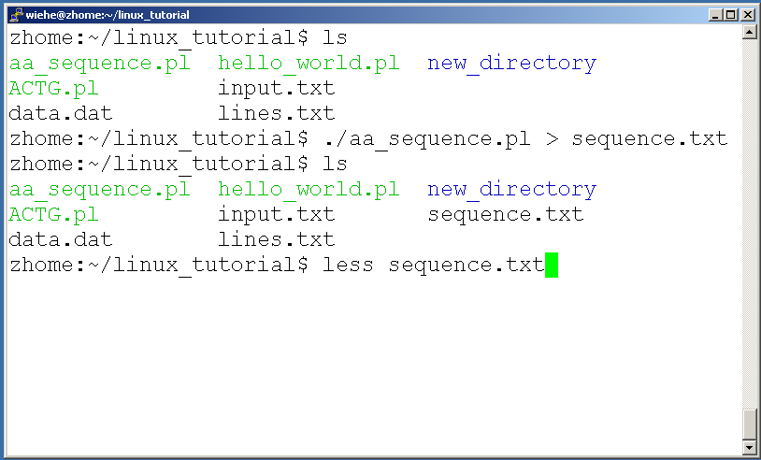
A few examples of piping

Slide 34
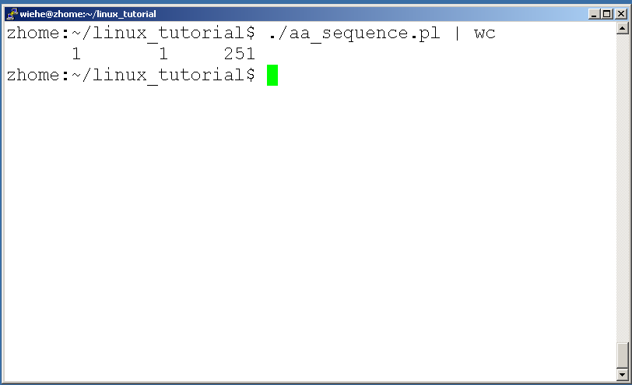
A few examples of piping

Slide 35
Command: script
Recording a shell session
By default, the session will be saved to a file named typescript
script filename
exit: terminate the script session

Slide 36
In-class lab 2:
Using script to capture your work for lab 2, save it to your lab2.txt, and submit file in iLearn.
1. you can use vim to create a file, or “cat” to create a simple file, or download a file named “science.txt” from iLearn
2. you do not need to physically print out the file, just give out the command you use

Slide 37
Assignment 2: Handwritten Hardcopy is Due Jan 29th in class
Read and practice commands in chapter 3
Page79 – 80: 1, 3, 5, 6, 11, 12, 13

